Slide 1
Green House Effect & Global Warming
Dr Indranil Ghosh
Associate Professor

Slide 2
What is Green house?
A greenhouse (also called a glasshouse, or, if with sufficient heating, a hothouse) is a structure with walls and roof made chiefly of transparent material, such as glass, in which plants requiring regulated climatic conditions are grown. These structures range in size from small sheds to industrial-sized buildings. A miniature greenhouse is known as a cold frame. The interior of a greenhouse exposed to sunlight becomes significantly warmer than the external temperature, protecting its contents in cold weather.

Slide 3
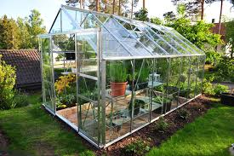

Slide 4
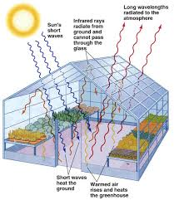
Theory of Operation
The warmer temperature in a greenhouse occurs because incident solar radiation passes through the transparent roof and walls and is absorbed by the floor, earth, and contents, which become warmer. As the structure is not open to the atmosphere, the warmed air cannot escape via convection, so the temperature inside the greenhouse rises.

Slide 5
Natural Green House | Artificial Green House
It is created naturally | It is created by humans.
Green house gases in the atmosphere trap the radiation to warm the earth. | Transparent glass wall allows to pass through certain amount of radiation but traps the radiation of certain amount by not letting them to escape.
It creates heating effect in the whole earth. | It creates heating effect relatively small area.

Slide 6
What is Green House effect?
The Earth’s atmosphere bottles up the energy of the Sun, and is said to act like a ‘green house’. and water vapour in the atmosphere which develop a gaseous blanket over the surface, transmit ‘short wavelength solar radiation’ but reflect the heat radiation having ‘longer wave length’. CO2molecules, water vapour and other few gaseous molecules are transparent to incoming solar radiation but not to the heat radiated by the Earth’s surface. So they trap and re-emit the solar radiation to the surface. As a result, the surface warms up.
This progressive warming up of the Earth’s surface due to the blanketing effect of CO2 & water vapour in the atmosphere is called as Green house effect.

Slide 7
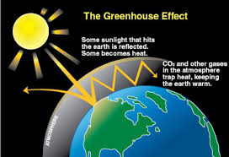
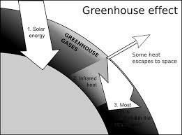

Slide 8
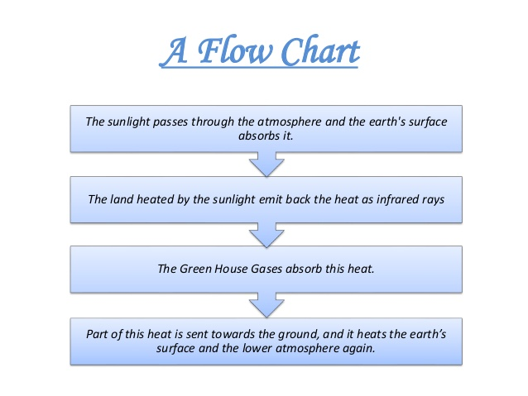

Slide 9
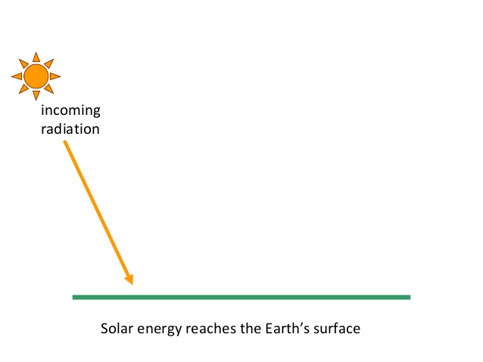

Slide 10
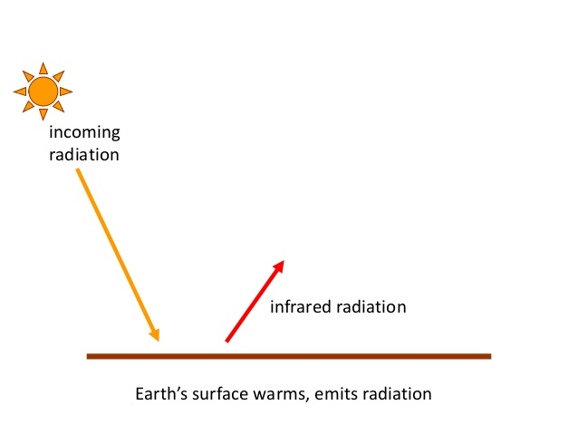

Slide 11
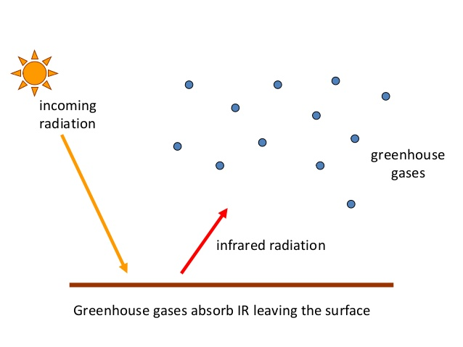

Slide 12
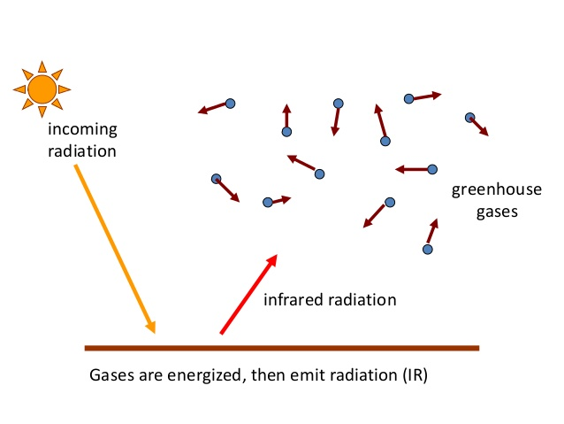

Slide 13
Green House Gases
Most of the long wavelength energy radiated by the Earth is absorbed by a combination of some active gases and re-emits to the surface again. These gases are known as Green House Gases (GHG). These are water vapour , carbon-dioxide (CO2), methane nitrous oxide, molecular oxygen and ozone

Slide 14
Impact of Green House Effect on Mars and Venus
Mars has almost no green house effect. Due to lack of atmospheric pressure (0.006 atm), a little atmosphere is over there. In this little atmosphere, green house effect is barely apparent. As a result, surface temperature of the Mars is very low hence life is not there.
On the other hand, the atmospheric pressure of Venus is 100 times greater than Earth and the concentration of in the atmosphere is 97%. In this atmosphere green house effect is maximum and so the surface temperature of the Venus is very high This high temperature is also not suitable for the living organism and so Venus is free from life.

Slide 15
Mechanism of Absorption of IR Radiation by CO2
The entire range of radiation emitted by Earth falls in the infrared (IR) region (4-20 μm). The interaction of infrared radiation with CO2 molecules makes them go from one vibration energy level to another vibration energy level. The essential condition for the radiation to interact is that vibration mode should be associated with a change in dipole moment. However, mononuclear gas molecules N2 and O2 do have vibration energy levels, but are symmetrically stretched or compressed, thus involve no change in dipole moment. As a result they do not interact with infrared radiation and transparent to infrared radiation.
On the other hand, CO2 involves change in dipole moment hence absorbs infrared radiation and so it is considered as a green house gas.
https://youtu.be/AF1JPg20amY
https://youtu.be/0S_bt3JI150

Slide 16
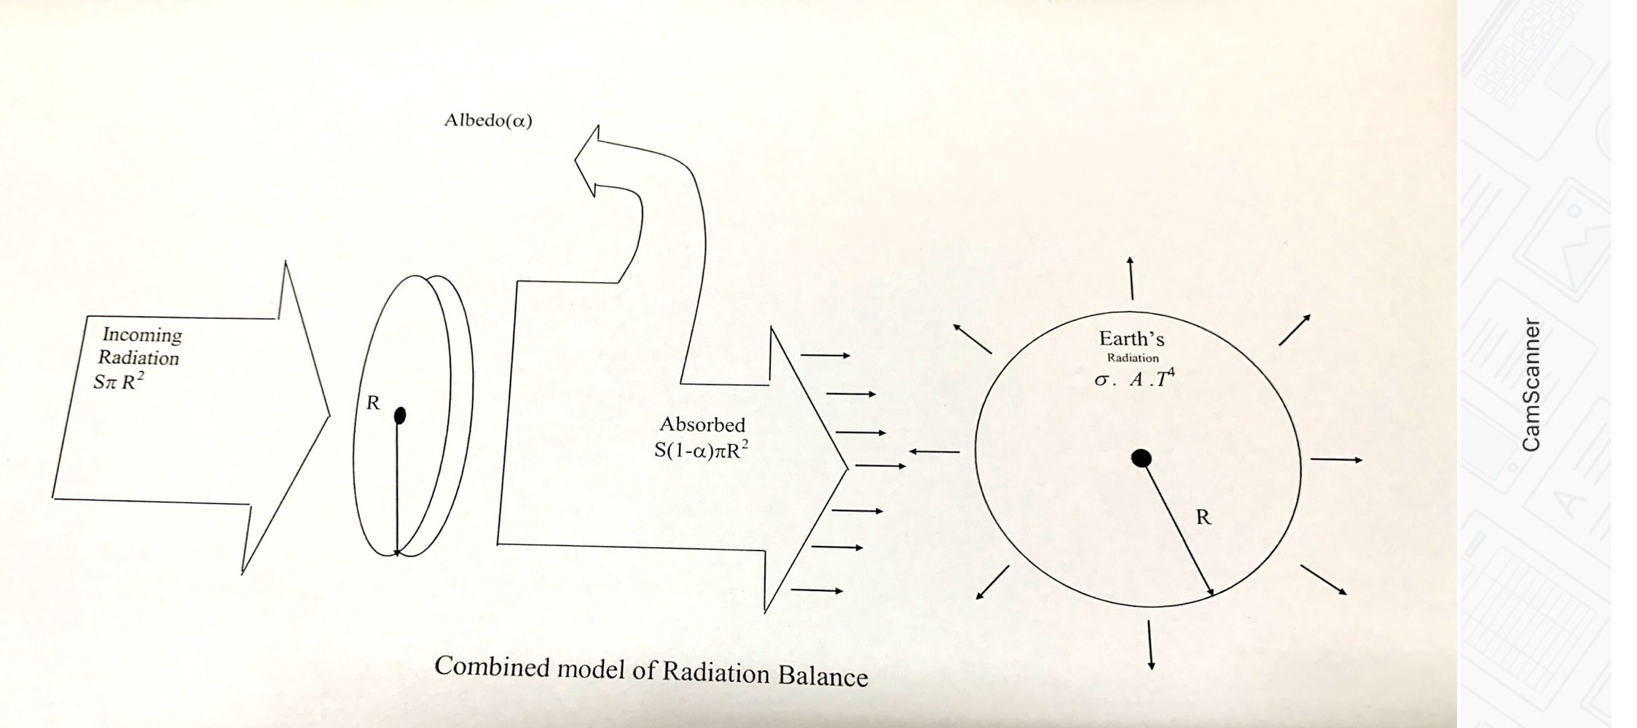
Earth’s Average Surface Temperature

Slide 17
Assumption
Both Earth and Sun behave like a blackbody.
Radiation from the Sun arises just outside the Earth’s atmosphere with an average annual solar intensity which is equal to 1372 W/m2
the all the solar radiation which fall on the surface of the Earth and contribute to the surface temperature, should pass through a disc having radius equal to that of Earth.
30% of the total incoming solar radiations returns back to the space without contributing anything to the Earth’s surface temperature. This amount of radiation is known as ‘Earth’s albedo’.
Remaining incoming energy absorbs by the Earth’s surface.

Slide 18
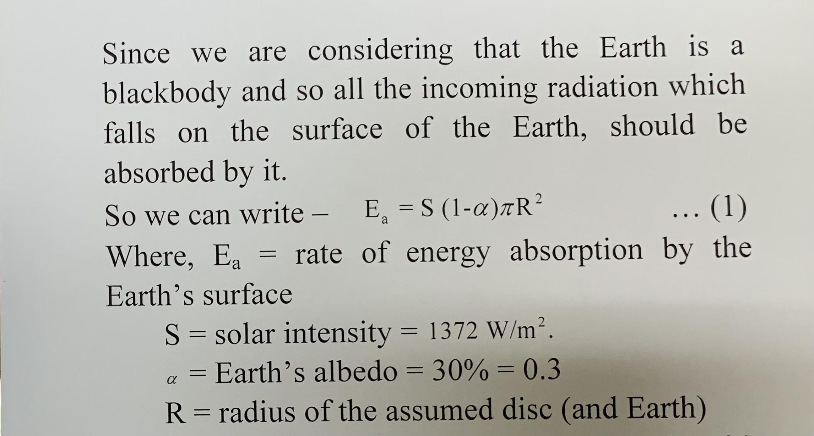

Slide 19
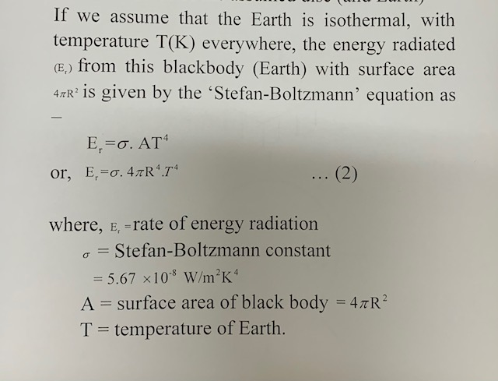

Slide 20
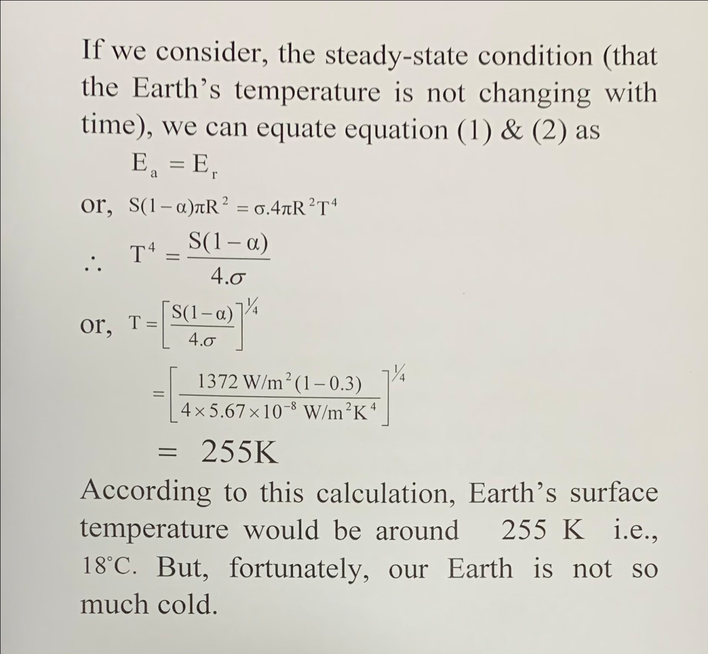

Slide 21
The actual temperature of our Earth is 288 K i.e., This indicates that, the surface is [15-(-18)]°C i.e. 33°C hotter than the predicted value. The key factor that makes our calculation differ from the actual result is that we never consider the interactions between the atmosphere and radiation, i.e., emitted by the Earth’s surface. This key factor is nothing but ‘Green House’ effect.

Slide 22
The incoming solar radiation having shorter wavelength can easily penetrate the gaseous layer of water vapour etc. (green house gases) which is present just above the surface. After strike on surface, certain amount of radiation absorbed by it and then radiated back to the space. This radiated energy having longer wavelength (usually I. R. range) is not able to escape through the gaseous layer and absorbed there. Certain portion of this absorbed radiation then re-emitted back to the surface, resulting ‘heat trapped’. This trapped heat compensates that to the Earth’s surface. As a result, the average temperature of the Earth’s surface remains constant at 15oC.

Slide 23
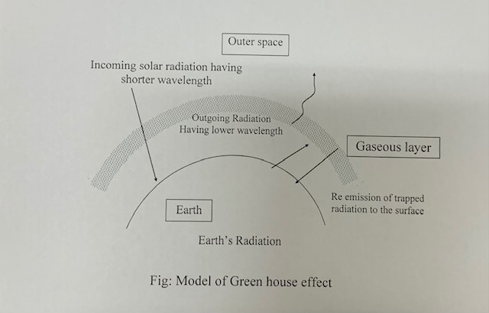

Slide 24
Atmospheric’ Radiative Window
All the incoming solar energy, as it arrives just outside the Earth’s atmosphere has wavelengths less than 3 µm, while the outgoing energy radiated by the Earth has essentially wavelength greater than 3 µm.
As radiant energy attempts to pass through the atmosphere, various gases and aerosols in the air affect it. As the atoms in the gaseous molecules vibrate towards and away from each other (vibrational energy) or rotate around each other (rotational energy), they absorb and radiate energy in specific wavelengths. When the frequency of these molecular oscillations is close to the frequency of the passing radiant energy, the molecule can absorb that energy. Most of the long-wavelength energy radiated by the Earth is absorbed by a combination of radiatively active gases, most important of which are water vapour (H2O) , carbon-di-oxide (CO2) methane (CH4) nitrous oxide (N2O). oxygen (O2) & ozone (O3) . All these gases (green house gases) have capacity to absorb the radiated energy of different range of frequencies (3-40μ m) But any gas present in the atmosphere can, not absorb radiated energy having wavelength in between 7 µm and 12 µm. The reason behind this is that the frequency of this energy does not match with the frequency of molecular oscillations of any gas present in the atmosphere. As a result, this radiated energy can easily be escaped to the space. This relatively clear sky for this outgoing energy, is referred as the atmospheric radiative window.

Slide 25
Global Warming
The slow gradual rise in the temperature of the Earth due to emission of excess quantities of radiation trapping gases (green house gases), is called ‘Global warming’. It is estimated that by 2030 the average global temperature will have risen by 1 to 3ºC .
The green house gases absorb the radiated heat and re-emit to the surface again to maintain the optimum temperature of the surface. This is called green house effect. But, due to rapid industrialization, the rate of emission of green house gases specially , water vapour is increasing and as a result the slow and gradual rise in temperature is taking place. Thus, the excess green house effect is responsible for the ‘Global warming’.

Slide 26
Impact of Global Warming on Environment
Impact on Climate change:
Due to increase of average global temperature, water from various sources on Earth may evaporate more rapidly and as a result of which the overall amount of rainfall may increase. But this phenomenon will not occur evenly in all the parts of the Earth, there may be heavy rainfall in some parts and drought in some other parts of the world. In some region, the summer may be hotter & prolonged, and winter becomes shorter & warmer.

Slide 27
Increase of Sea water level:
If the global temperature increases, the ice-caps and glaciers of the polar regions of the Earth may be melted partially, the floating ice on the water of the seas may also melt partially or completely. Due to an increase in temperature there may be an expansion of volume of sea water and as a result of which the level of sea water may rise. If the global temperature increases by on average, then a vast populated low-land area of the world specially coastal areas may be flooded.

Slide 28
Impact on Agriculture
An increase in the amount of in air is favourable for an increasing rate of photosynthesis of plants, therefore increase in may increase the production of crops in some cases and on the other hand crop production may be reduced in some cases due to dry soil having higher temperature. There may be acute scarcity of water for irrigation in some places. In some regions, again, production of crops may decrease due to soil erosion rate becoming faster due to heavy rainfall and washing away of fertile top soil reducing thereby the available cropland area.

Slide 29
Impact on marine food
Due to increase in temperature, the ice-caps, glaciers melt and as a result, expansion of volume of sea-water takes place. This expansion reduces the concentration of salts and changes the pH of the sea water. The average temperature of sea water is also changed. This changed environment is not suitable for the existence of different marine living organisms, especially fish. Different marine algae that are considered as food also die due to this disturbed condition.

Slide 30
Adaptation:
Adaptation to global warming consists of initiatives and measures to reduce the vulnerability of natural and human systems against actual or expected climate change effects. This is in distinction to the mitigation of global warming.
It is very likely that adaptation to global warming is inevitable as it is unlikely that levels of greenhouse gases can be kept low enough to avoid a projected temperature rise of 2ºC .

Slide 31
Control the ‘Global warming’
Mitigation
The global energy policy has set a target of limiting the global temperature rise to 2ºC (3.6ºF) compared to preindustrial levels, of which 0.8ºC has already taken place and another 0.5ºC is already committed.
The 2ºC rise is typically associated in climate models with a carbon dioxide concentration of 400-500 ppm by volume; the current level as of January 2007 is 383 ppm by volume, and rising at 2 ppm annually. Hence, to avoid a very likely breach of the 2ºC target, CO2 levels would have to be stabilised very soon; this is generally regarded as unlikely, based on current programs in place to date.

